Slide 1
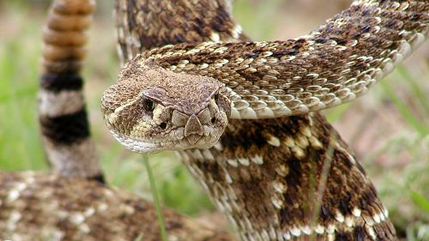
Toxin Overlap in Crotalus Snake Genus: Analyzing Venom Composition
River Kaveney
BIO 5202
This Photo by Unknown Author is licensed under CC BY-NC

Slide 2
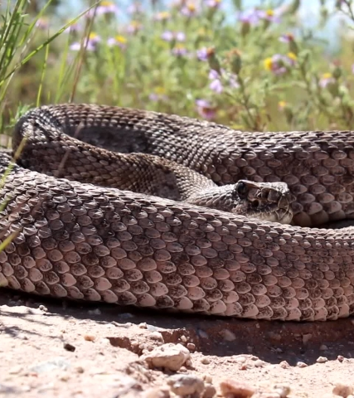
Background
Crotalus snakes are a medically significant genus due to their expansive habitat range
Understanding venom composition is crucial for targeted antivenom development

Slide 3
Research Motivation
Toxin variability complicates treatment due to the high specificity of antivenoms
An antivenom that targets major toxins families across an entire genus of snakes would remove some of the specificity

Slide 4
Research Questions
How much toxin overlap exists between snakes in the Crotalus genus?
What are the most common venom toxins across the genus?
How similar/different are venom compositions between snake species within the genus?

Slide 5
Objectives
Framework for analyzing venom composition
Develop R script for data import, cleaning, and visualization
Summarize toxin distribution across crotalid species
Identify high-prevalence toxins as potential antivenom targets

Slide 6
Methods – Data Collection
Data collected from peer reviewed publications covering proteomic and transcriptomic profiling of venoms
Created a binary presence/absence dataset for the following species:
Crotalus adamanteus
Crotalus atrox
Crotalus Basiliscus
Crotalus horridus
Crotalus molossus
Crotalus scutulatus
Dataset covers major toxin families

Slide 7
Methods – Data Analysis
Import and clean data set
Transform to long format for visual clarity
Plot a heatmap to visualize toxin presence
Export figure for reporting

Slide 8
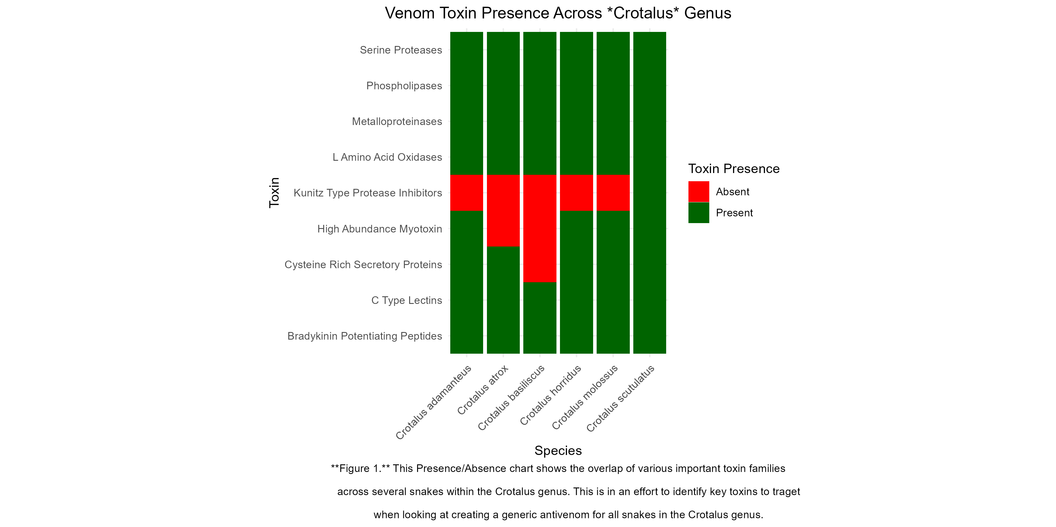
Results

Slide 9

Key Findings
6 common toxins across the chosen crotalid species to focus on
Serine Proteases
Phospholipases
Metalloproteinases
L-Amino Acid Oxidases
C-Type Lectins
Bradykinin Potentiating Peptides

Slide 10
Conclusions
Crotalid venoms show meaningful overlap
Findings may guide more efficient antivenom design
Future work:
Expand the data set with additional species
Move from binary presence/absence to more detailed heatmap that scales a gradient of color based on each toxin’s percent of total venom composition

Slide 11
References
Borja, M., Castañeda-Gaytán, G., Alagón, A., Strickland, J. L., Parkinson, C. L., Gutiérrez-Martínez, A., Rodríguez-López, B., Zarzosa, V., Lomonte, B., Saviola, A. J., Fernández, J., Smith, C. F., Hansen, K. C., Pérez-Robles, A., Castañeda-Pérez, S., Hirst, S. R., Olvera-Rodríguez, F., Fernández-Badillo, L., Sigala, J., Jones, J., Montaño-Ruvalcaba, C., Ramírez-Chaparro, R., Margres, M. J., Acosta-Campaña, G., & Neri-Castro, E. (2025). Venom variation and ontogenetic changes in the Crotalus molossus complex: Insights into composition, activities, and antivenom neutralization. Comparative Biochemistry and Physiology Part C: Toxicology & Pharmacology, 290, 110129. https://doi.org/10.1016/j.cbpc.2025.110129
Calvete, J. J., Fasoli, E., Sanz, L., Boschetti, E., & Righetti, P. G. (2009). Exploring the venom proteome of the western diamondback rattlesnake (Crotalus atrox) via snake venomics and combinatorial peptide ligand library approaches. Journal of Proteome Research, 8(6), 3055–3067. https://doi.org/10.1021/pr900249q
Rokyta, D. R., Lemmon, A. R., Margres, M. J., & Aronow, K. (2012). The venom-gland transcriptome of the eastern diamondback rattlesnake (Crotalus adamanteus). BMC Genomics, 13, Article 312. https://doi.org/10.1186/1471-2164-13-312
Rokyta, D. R., Wray, K. P., & Margres, M. J. (2013). The genesis of an exceptionally lethal venom in the timber rattlesnake (Crotalus horridus) revealed through comparative venom-gland transcriptomics. BMC Genomics, 14, Article 394. https://doi.org/10.1186/1471-2164-14-394
Segura, Á., Herrera, M., Reta Mares, F., Jaime, C., Sánchez, A., Vargas, M., Villalta, M., Gómez, A., Gutiérrez, J. M., & León, G. (2017). Proteomic, toxicological, and immunogenic characterization of Mexican west-coast rattlesnake (Crotalus basiliscus) venom and its immunological relatedness with the venom of Central American rattlesnake (Crotalus simus). Journal of Proteomics, 158, 62-72. https://doi.org/10.1016/j.jprot.2017.02.015
Strickland, J. L., Mason, A. J., Rokyta, D. R., & Parkinson, C. L. (2018). Phenotypic variation in Mojave rattlesnake (Crotalus scutulatus) venom is driven by four toxin families. Toxins, 10(4), Article 135. https://doi.org/10.3390/toxins10040135

Slide 12

Questions?

